Slide 1
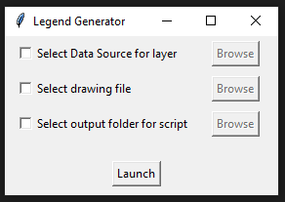
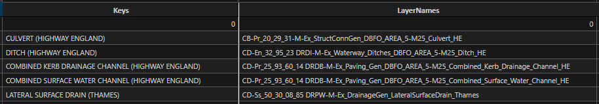
Utility Legend Generator
Legend Generator is a new tool designed using Python win32com module to streamline the creation of utility key legends for highway utility drawings in AutoCAD. This user-friendly tool features an intuitive interface with three checkboxes and corresponding browse buttons, each serving a specific function to facilitate the legend generation process.
Key Features:
DATA SOURCE SELECTION: The first checkbox allows users to select a source file that contains all necessary layers and keys for legend creation. This ensures that the legends are generated accurately based on the provided data. It is mandatory to select a data source before pressing Launch button. *note: data source file must be an .xlsx file and have column names for keys and layer names as: “Keys” and “LayerNames” respectively. For clarity, please refer the below image:

Slide 2
Utility Legend Generator
2. TARGET DRAWING SELECTION: By choosing the second checkbox, users can enable the browse button to select a specific drawing file in which the legends will be created. This feature is optional; if the checkbox not selected, the tool would generate legends in the currently opened drawing.
3. LISP FILE CREATION: The third checkbox enables users to select a folder in which a LISP file will be generated. This feature is also optional; If used, a file with the same name as of the dwg file on which the tool is working with “.lsp” extension will be generated which would contain all the commands and instructions sent to AutoCAD during the legend creation process. Users can easily recreate the same legends by loading the LISP file into AutoCAD at any time.
4. LAUNCH BUTTON: This button launches the tool to start creating the legends.
The tool is designed to position the legends at the origin of the coordinate plane in AutoCAD’s model space, ensuring consistency and precision. We believe this tool will significantly enhance efficiency and accuracy in creating utility key legends, benefiting all team members involved in highway utility projects.
*Ensure ADEPT tool is already installed in your system to use this tool
*This is currently not available in automation library.
*For any help, suggestion or contribution in code please send an email to: Suman.Kumar@atkinsrealis.com

